Slide 1



Team LoopedIn
Simone J
Maddy B
Rachel G

Slide 2
Problem Domain
Low resource communities, East Palo Alto
K-12 education
Students, parents, and teacher communication
Notes:
Addressing the educational needs of low-resource communities in K-12 education. We are particularly interested in helping to facilitate communication between students, parents, and teachers.

Slide 3
Initial POV 1
We met a math teacher at East Side Prep.

Slide 4
Initial POV 1
We met a math teacher at East Side Prep.
We were surprised to find that teachers can’t grade everything, but want to.

Slide 5
Initial POV 1
We met a math teacher at East Side Prep.
We were surprised to find that teachers can’t grade everything, but want to.
It would be game changing if we could reduce the time spent grading homework while still providing students with individual feedback on their work.

Slide 6
Initial POV 2
We interviewed the academic director at a non profit tutoring program for students from East Palo Alto.

Slide 7
Initial POV 2
We interviewed the academic director at a non profit tutoring program for students from East Palo Alto.
We were surprised to learn that low resource parents have difficulty engaging with parent/teacher communication tools.

Slide 8
Initial POV 2
We interviewed the academic director at a non profit tutoring program for students from East Palo Alto.
We were surprised to learn that low resource parents have difficulty engaging with parent/teacher communication tools.
We think it would be game changing if we removed barriers to parent communication and involvement.

Slide 9
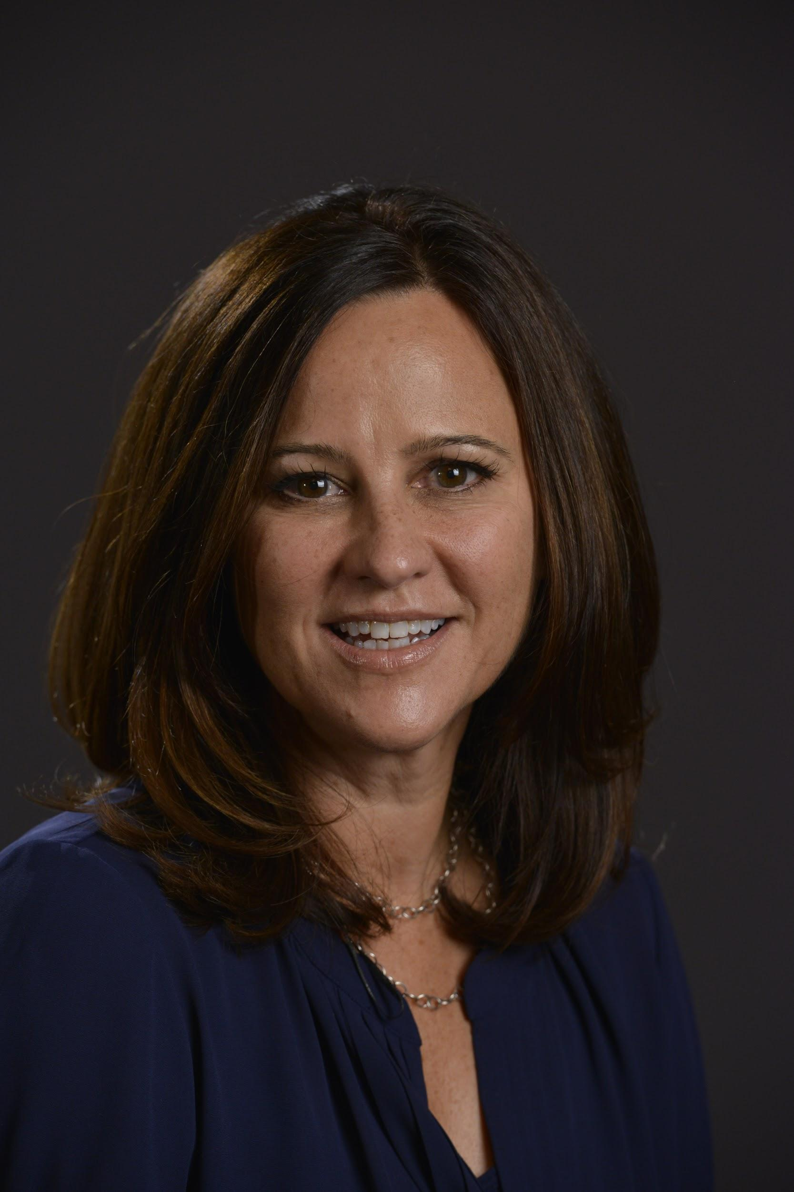
Additional Needfinding

Slide 10
Marianne Dray, Math Teacher (Palo Alto)
“It can get so adversarial, and teachers get frustrated that parents aren’t more involved... But really trying to build a team where the student is at the center and in charge, has the central role, and then you’re all working to some goal on behalf of the kid. I don’t know how to foster that, but it would be a great message. School communication can get so heated; it’s so personal."
Notes:
has worked at Gunn, where you rely on parents to be more involved
has worked at east side prep, where you provide the structure and support in stead of the parent

Slide 11
Zoe Woldorf, TFA Math Teacher (New Orleans)
"Teachers wish they had more time to talk to parents, but they have so many things to do that it becomes a lower priority. Contacting parents can’t happen until 7 pm and you can’t tell if you’re going to talk to parents for 5 minutes or an hour. And no one like talking to people they don’t know well on the phone… Sometimes parents get mad about not being called. Some want more communication, but they aren’t willing to make the first step and communicate with me.”

Slide 12
Ines, EPATT Parent
“We work all day, and we’re super busy, and then sports. We get home super late and sometimes I have to feed them dinner, shower, so it’s so hard to be in touch every day. So, I make deals with my kids about trust.”

Slide 13
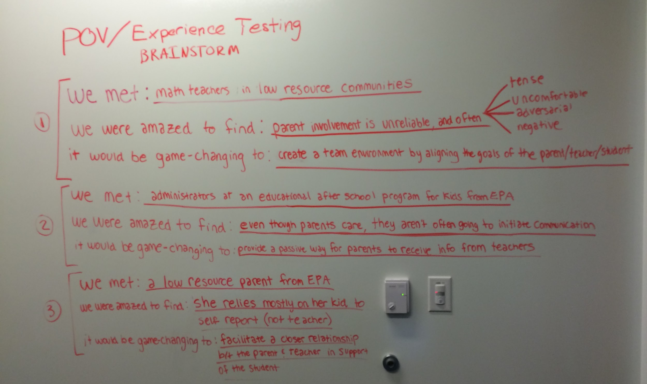
New POVs

Slide 14
New POV 1
We met math teachers in low resource communities.

Slide 15
New POV 1
We met math teachers in low resource communities.
We were amazed to find that they think communicating with parents is uncomfortable.

Slide 16
New POV 1
We met math teachers in low resource communities.
We were amazed to find that they think communicating with parents is adversarial.
It would be game changing to make parents, teachers, and students feel like a team.

Slide 17
New POV 2
We met education administrators at EPATT.

Slide 18
New POV 2
We met education administrators at EPATT.
We were amazed to find that parents don’t initiate communication with teachers, even though they care about their kids.

Slide 19
New POV 2
We met education administrators at EPATT.
We were amazed to find that parents don’t initiate communication with teachers, even though they care about their kids.
It would be game changing if we could provide a passive way for parents to receive information from teachers.

Slide 20
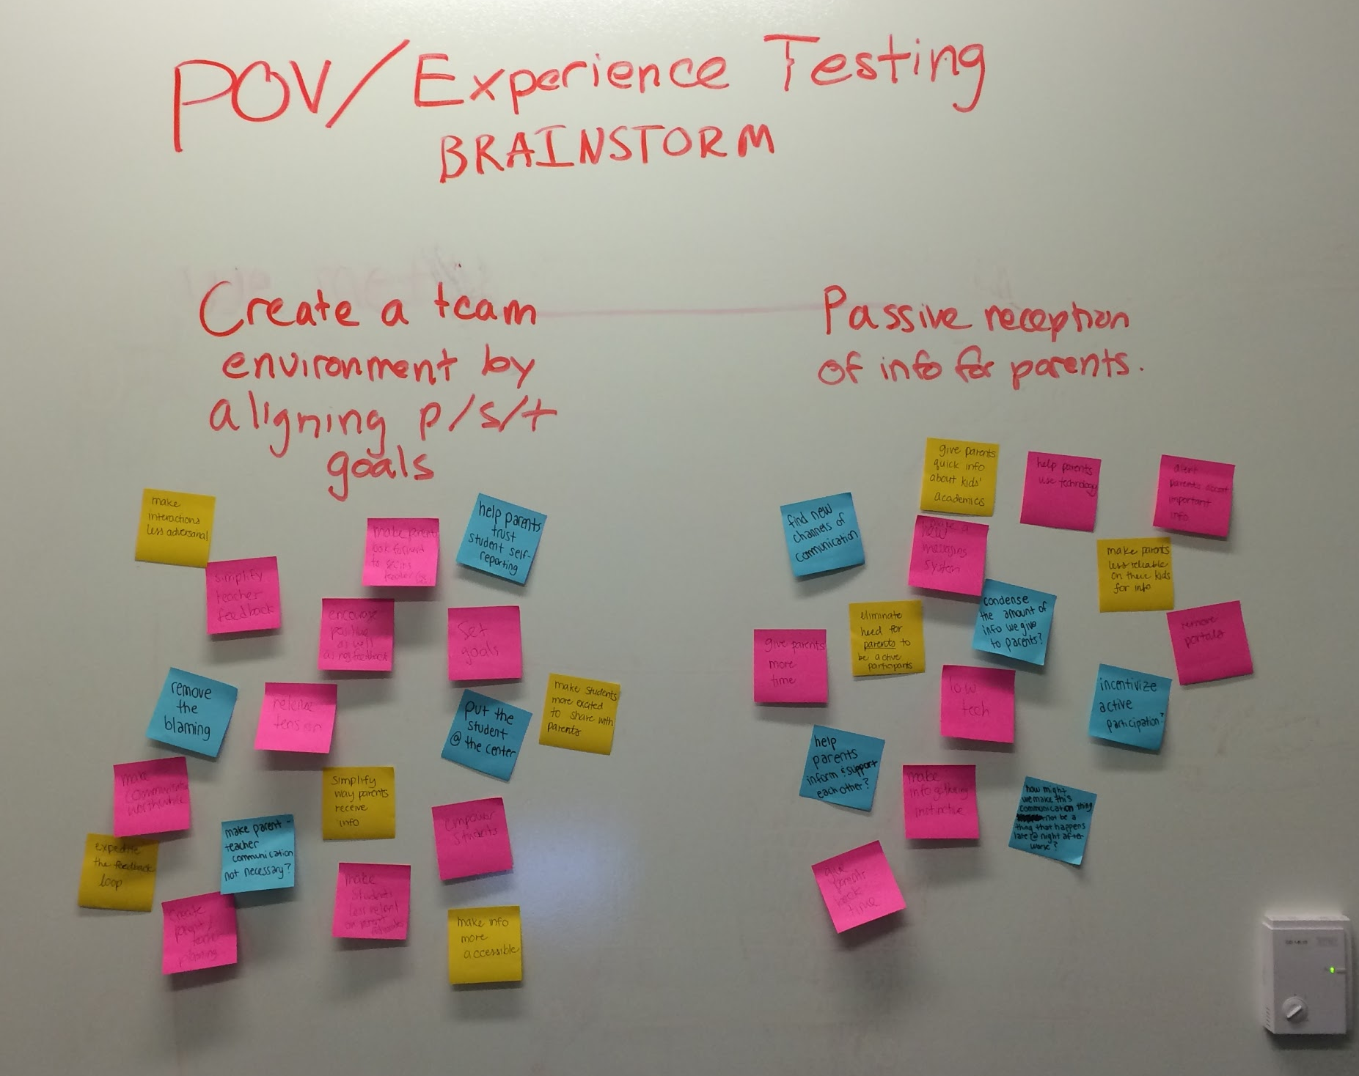
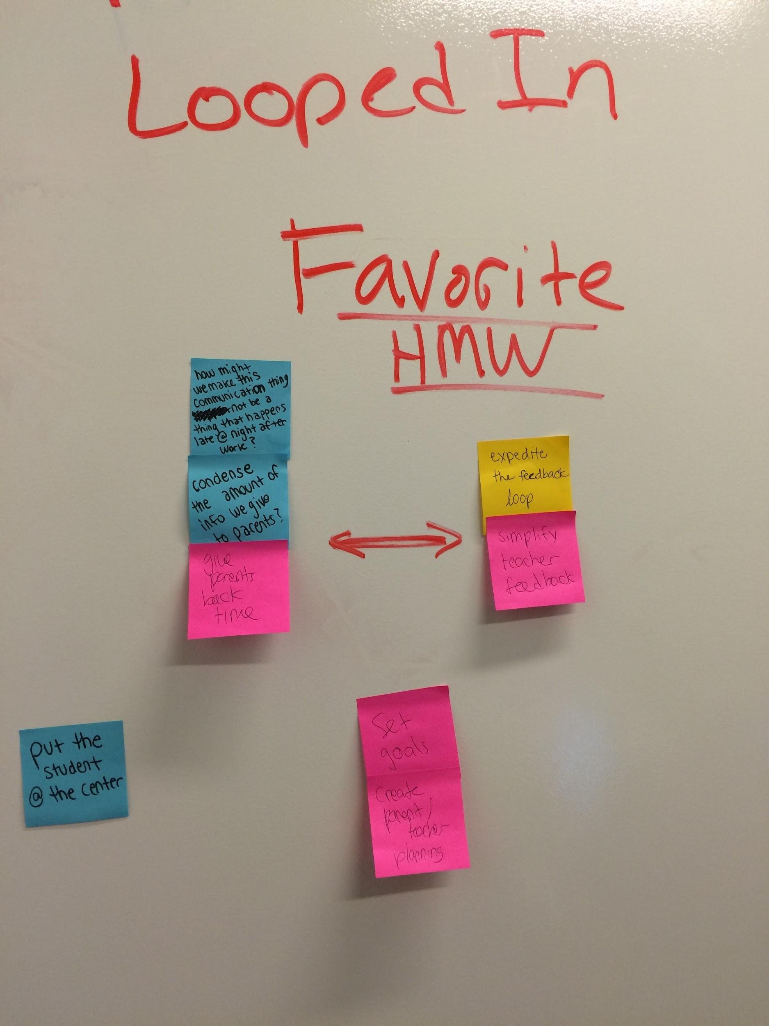
Top 3 HMW

Slide 21
Top 3 HMW
Expedite and simplify parent - teacher communication
Make time spent communicating less of a burden for parents
Create a team environment by setting goals, making plans together, and putting the student at the center

Slide 22
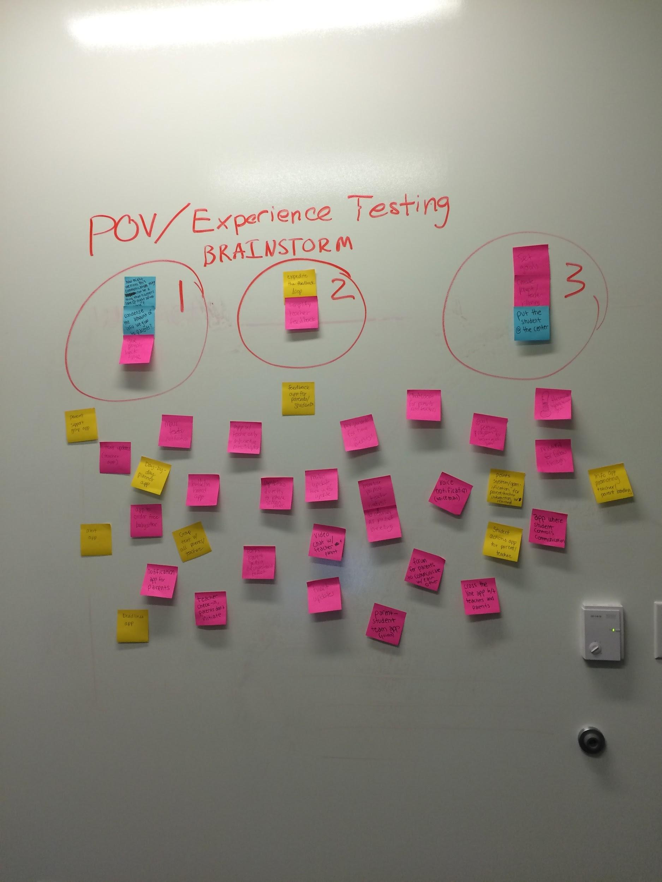
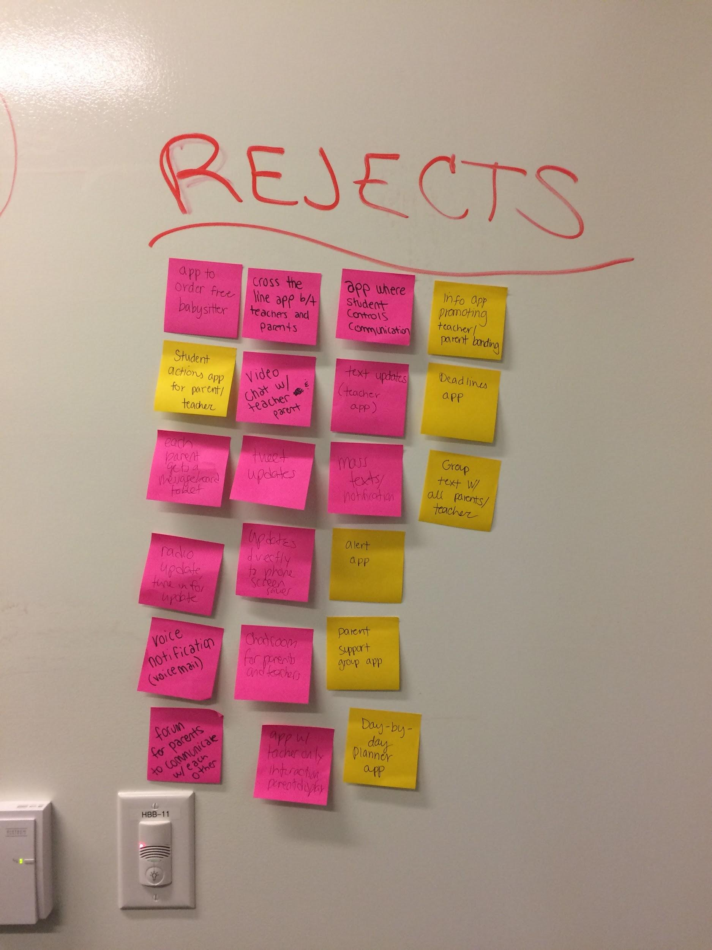
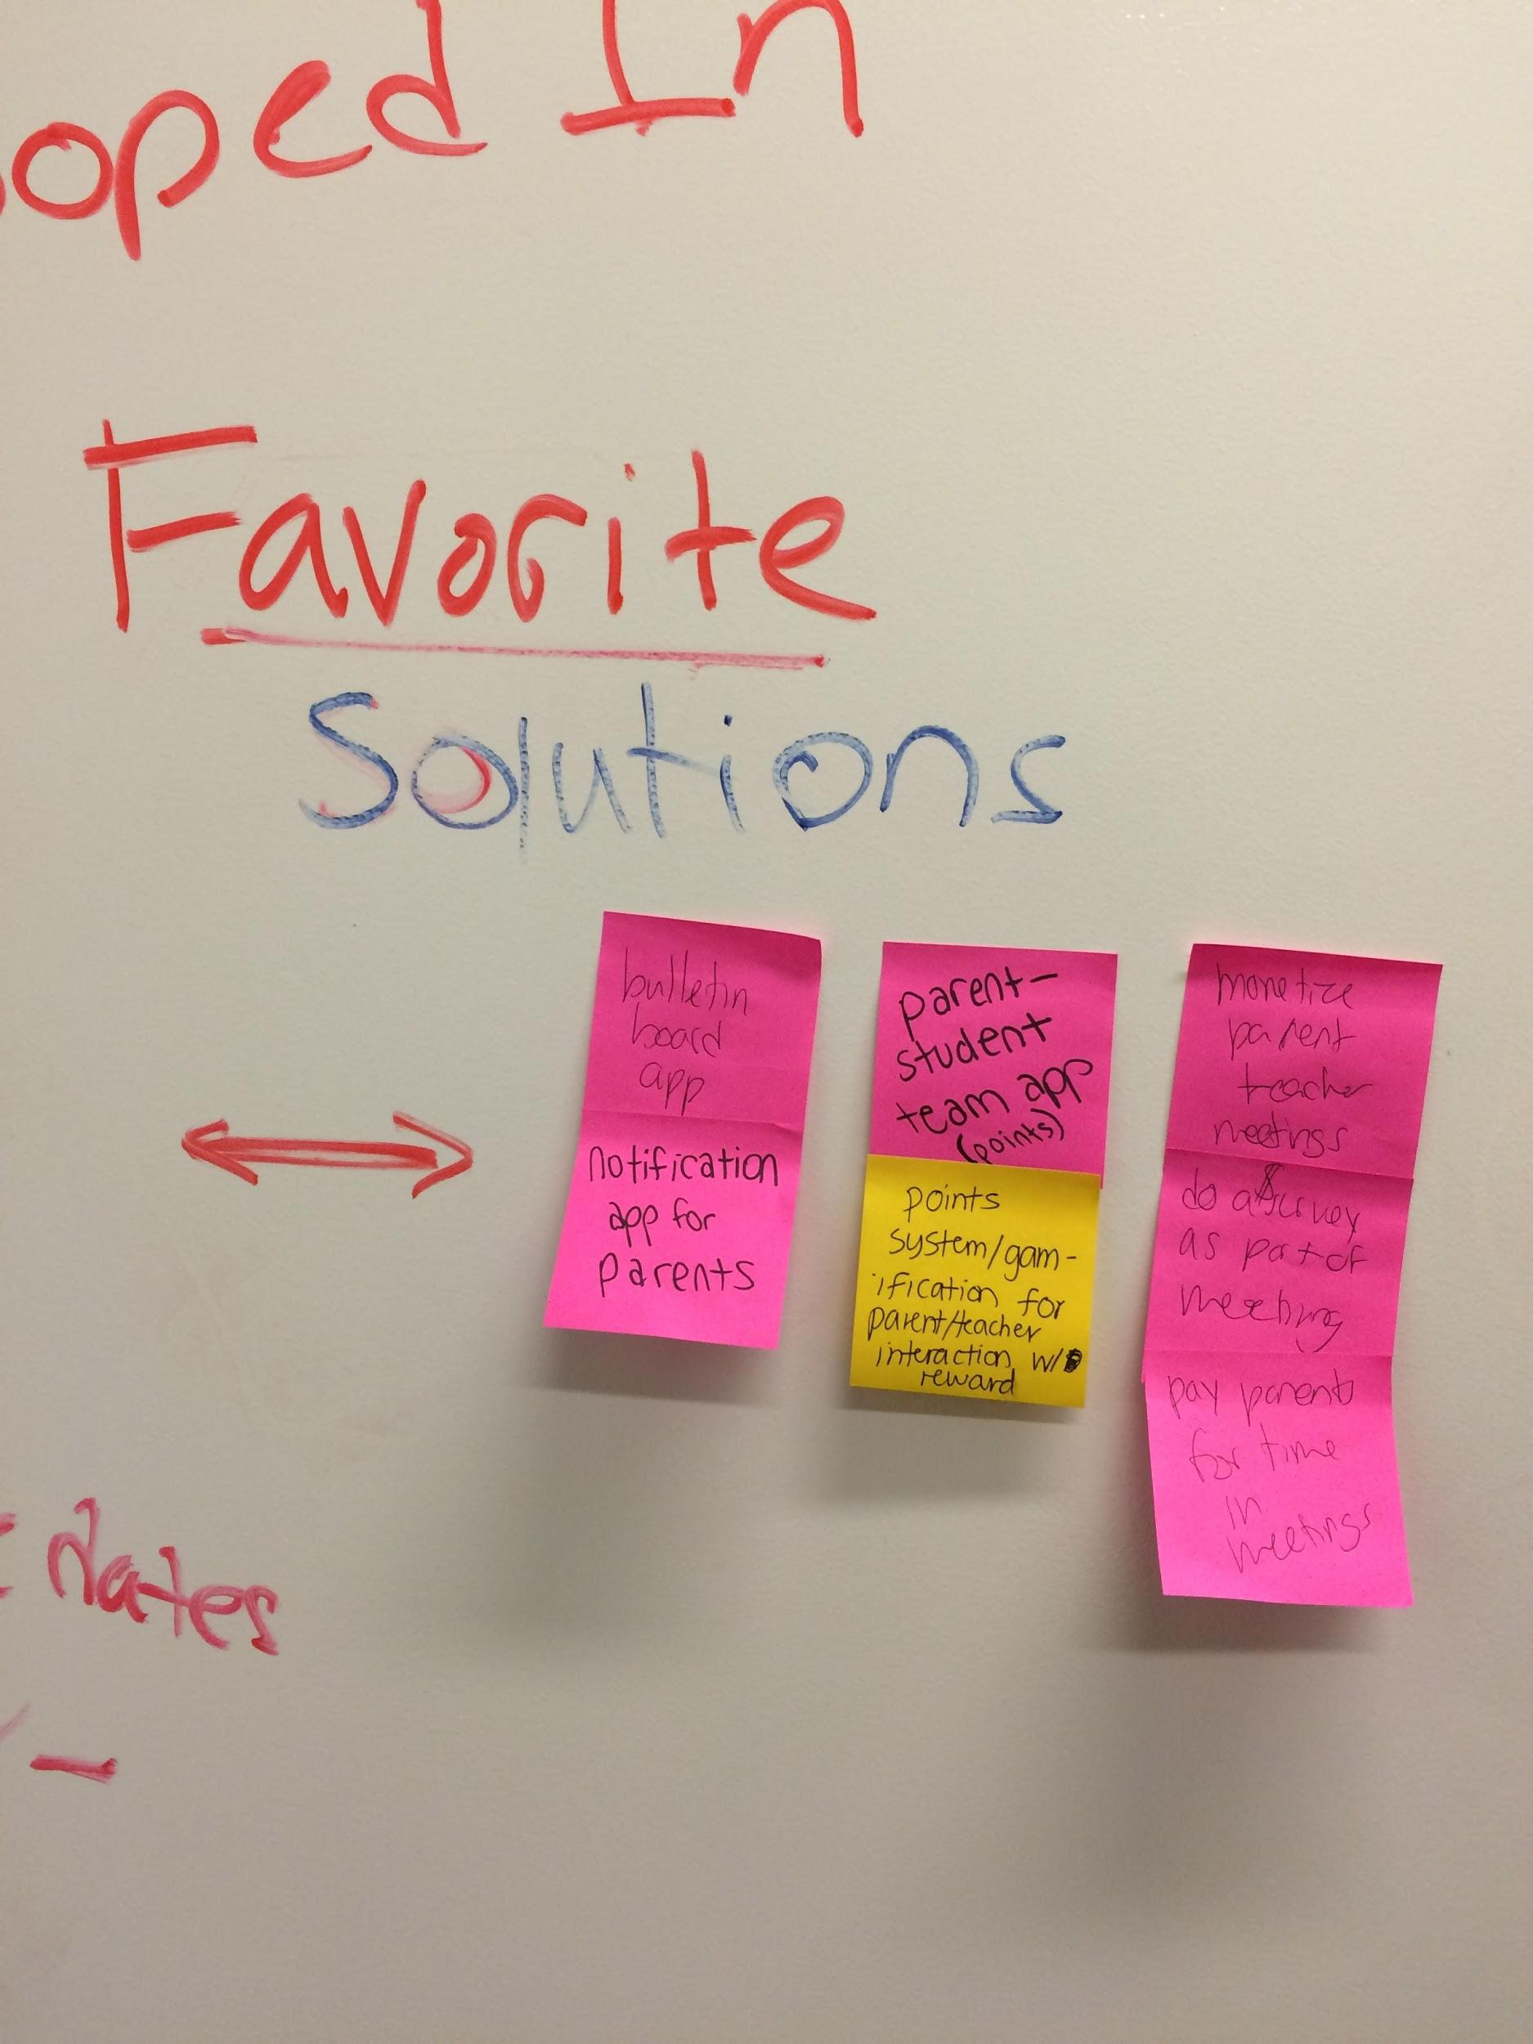
Solution Brainstorm

Slide 23
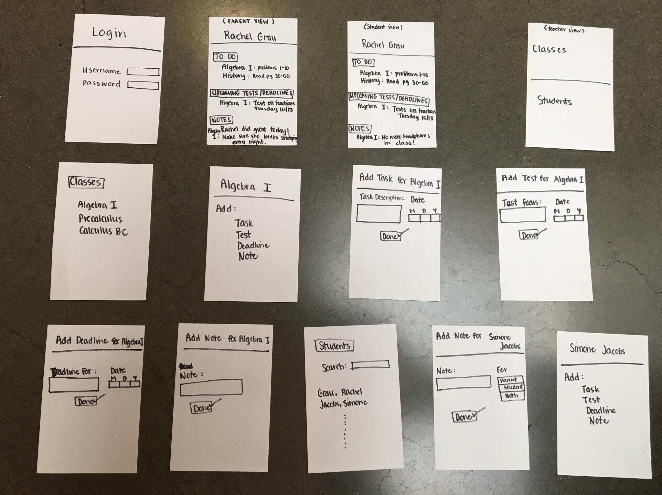
Experience Prototype 1
Bulletin app, super simple for parents, one page, low interactivity, notification to iphone

Slide 24
Experience Prototype 1
Interviewee:
Austin, Stanford Teacher Education Program (STEP)
Results
General flow and layout worked well
Very specific wording is important
More functionality: “learn more”, “uploads”, “how my child is doing”
Validity?
Assumption: Needs to be super simple to be usable, teachers have the motivation to take on the burden of communication
New Assumption: Parents and students can benefit from more resources on a portal platform

Slide 25
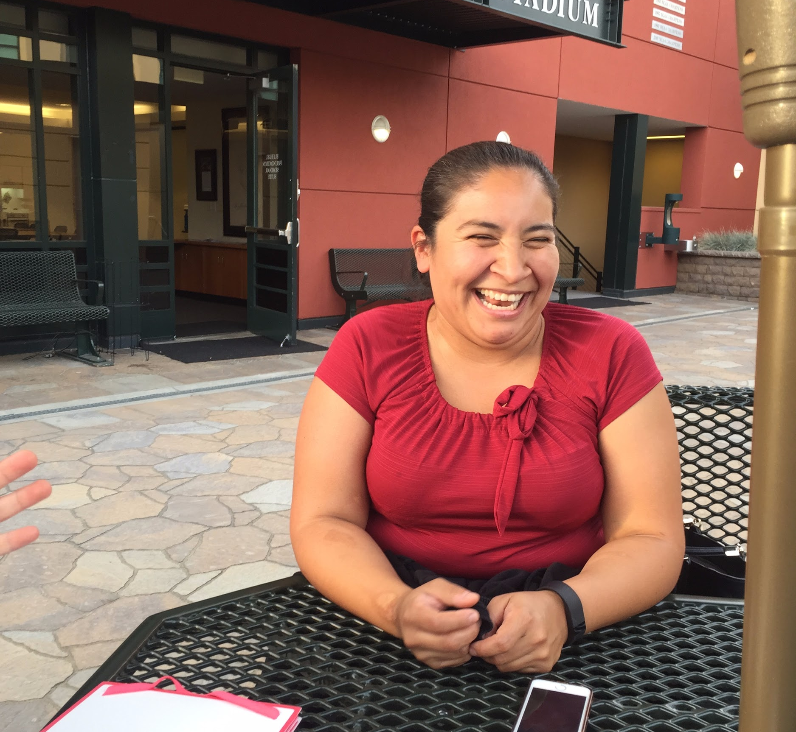
Experience Prototype 2
Points system/gamification for parent/teacher/student interaction, with reward (food/money/pizza party?) for number of interactions

Slide 26
Experience Prototype 2
Interviewee:
Anna, parent from EPATT
Results
Wanted to see the reward
Wanted to track progress
Concerned that there wouldn’t be funds for rewards
And wanted to work with a group instead of just with her kid
Validity?
Assumption: Parents need an incentive to make the time to communicate
New Assumption: Communality is important to parents

Slide 27
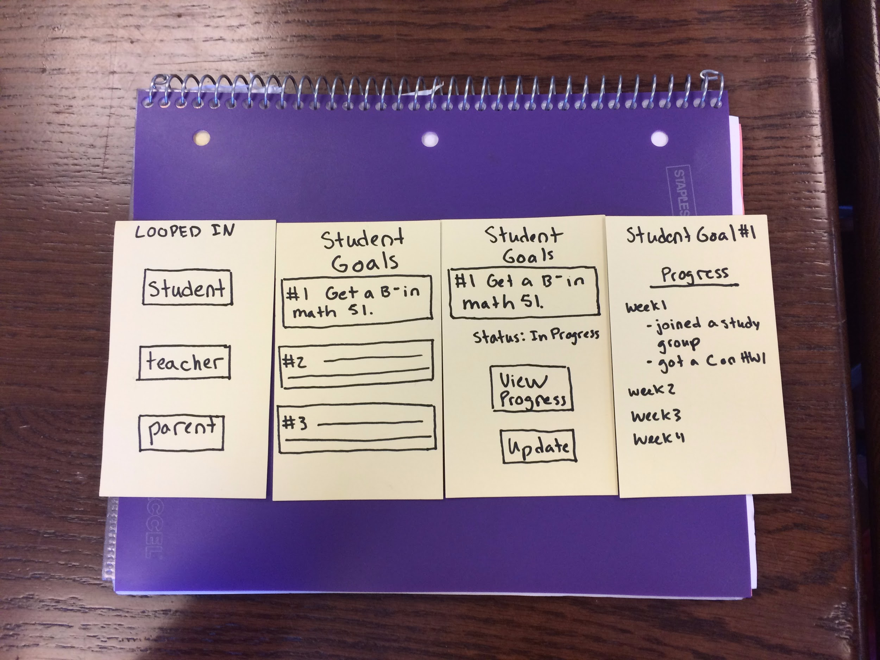
Experience Prototype 3
Goal setting program for back to school. P/S/T each set goals, can see how close they are to achieving them

Slide 28
Experience Prototype 3
Interviewee:
Margaret Seaton, freshman in college
Results
Students like snooping
Goal setting is hard
Don’t want to include the negative
Validity?
Assumption: Creating goals together will foster team spirit
New Assumption: Focus on accountability over teamwork

Slide 29
Looking Forward

